Slide 1

Prepared by: Dr. Nidhi Joshi
Asistant Professor
Career Development Cell
Parul Institute of Technology

Slide 2
Statistics
120 words are only needed to survive
2000 words are enough to understand the English language
10,000 words makes you Champaign in English
Native speakers known only around 20,000 words
Total number of English words are above 1 million
....Did You know vocabulary is more important than grammar.
The difficult task is to moemorize words

Slide 3
Truth of the matter is
People learn languages with different words and comes to us from various sources
1. Listening (Listen as often as you can)
2. Reading (While reading note difficult words)
3. Watching (Watch phonetics of native speakers)
4. Thinking (Very Important)

Slide 4

Actions
Read Read and Read
Read what you are intrested in, Novels, Magazines, Fiction, non-fiction, current affairs, sports etc.
Write: Write words with more detail.
Ex- Noun- Beauty, Verb- Beautify, Adj- Beautiful, Adverb- Beautifully
Root, suffix, prefix based words
Listen: Listen Audio, Video programs that interest you

Slide 5
Actions
Keep a dictionary and thesaurus handy
Learn a word a day
Play some games
Engage yourself in conversations

Slide 6
Way to Play Vocabulary Game (Word Association)
1. A word slide along with a picture will be shown.
2. After 5 to 7 minutes of preperation, Students must speak a story using some or all the words.

Slide 7

Night
business
Excitement
Population
tower
Buildings
Energy
modern
Crowded
Crime
Luxury

Slide 8
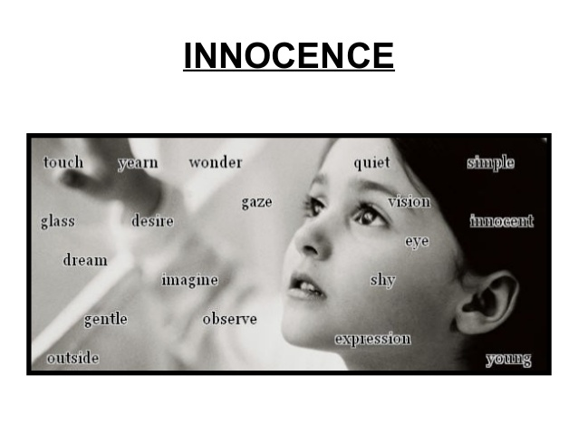

Slide 9
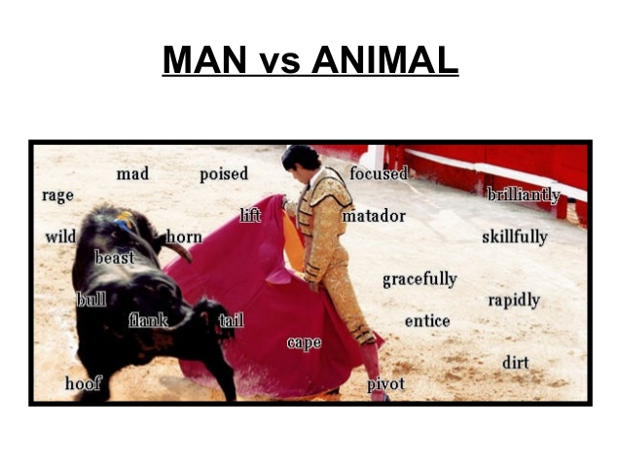

Slide 10
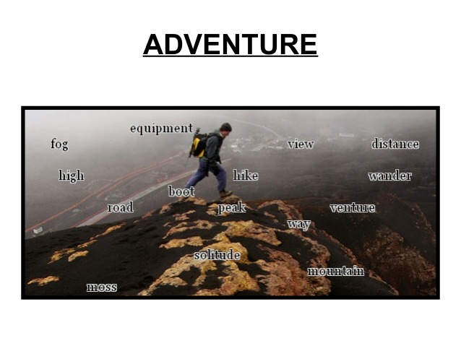

Slide 11


